Slide 1


micro:bit programming tutorial
Lesson 13
micro:bit basic lesson 13“Temperature controlled fan”
Yahboom micro:bit tutorial

Slide 2
micro:bit programming tutorial
Part1
Part 2
Part3
Part 4
Part 5
Learning goals
Preparation
Search for blocks
Combine blocks
Have a try
Yahboom micro:bit tutorial

Slide 3
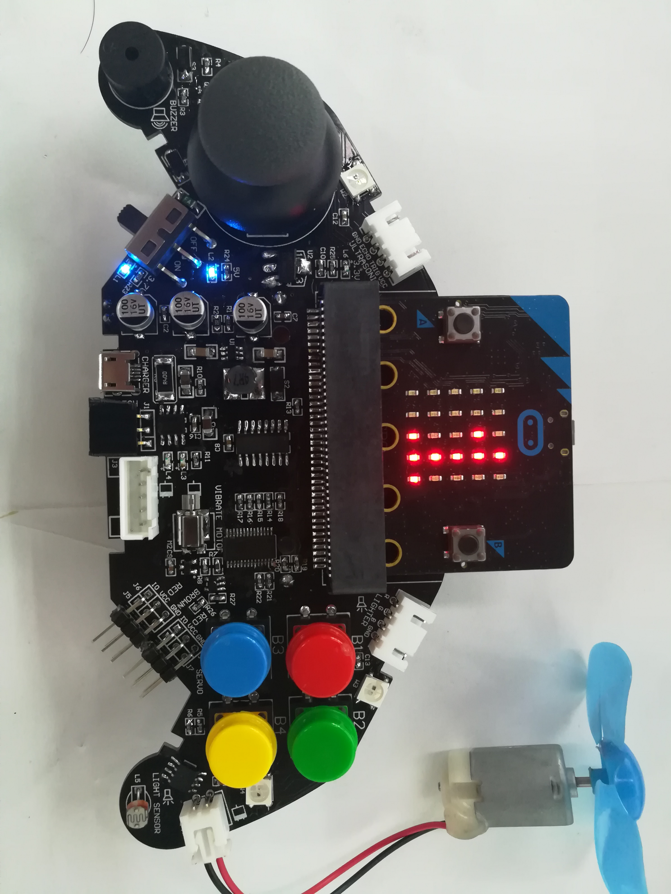
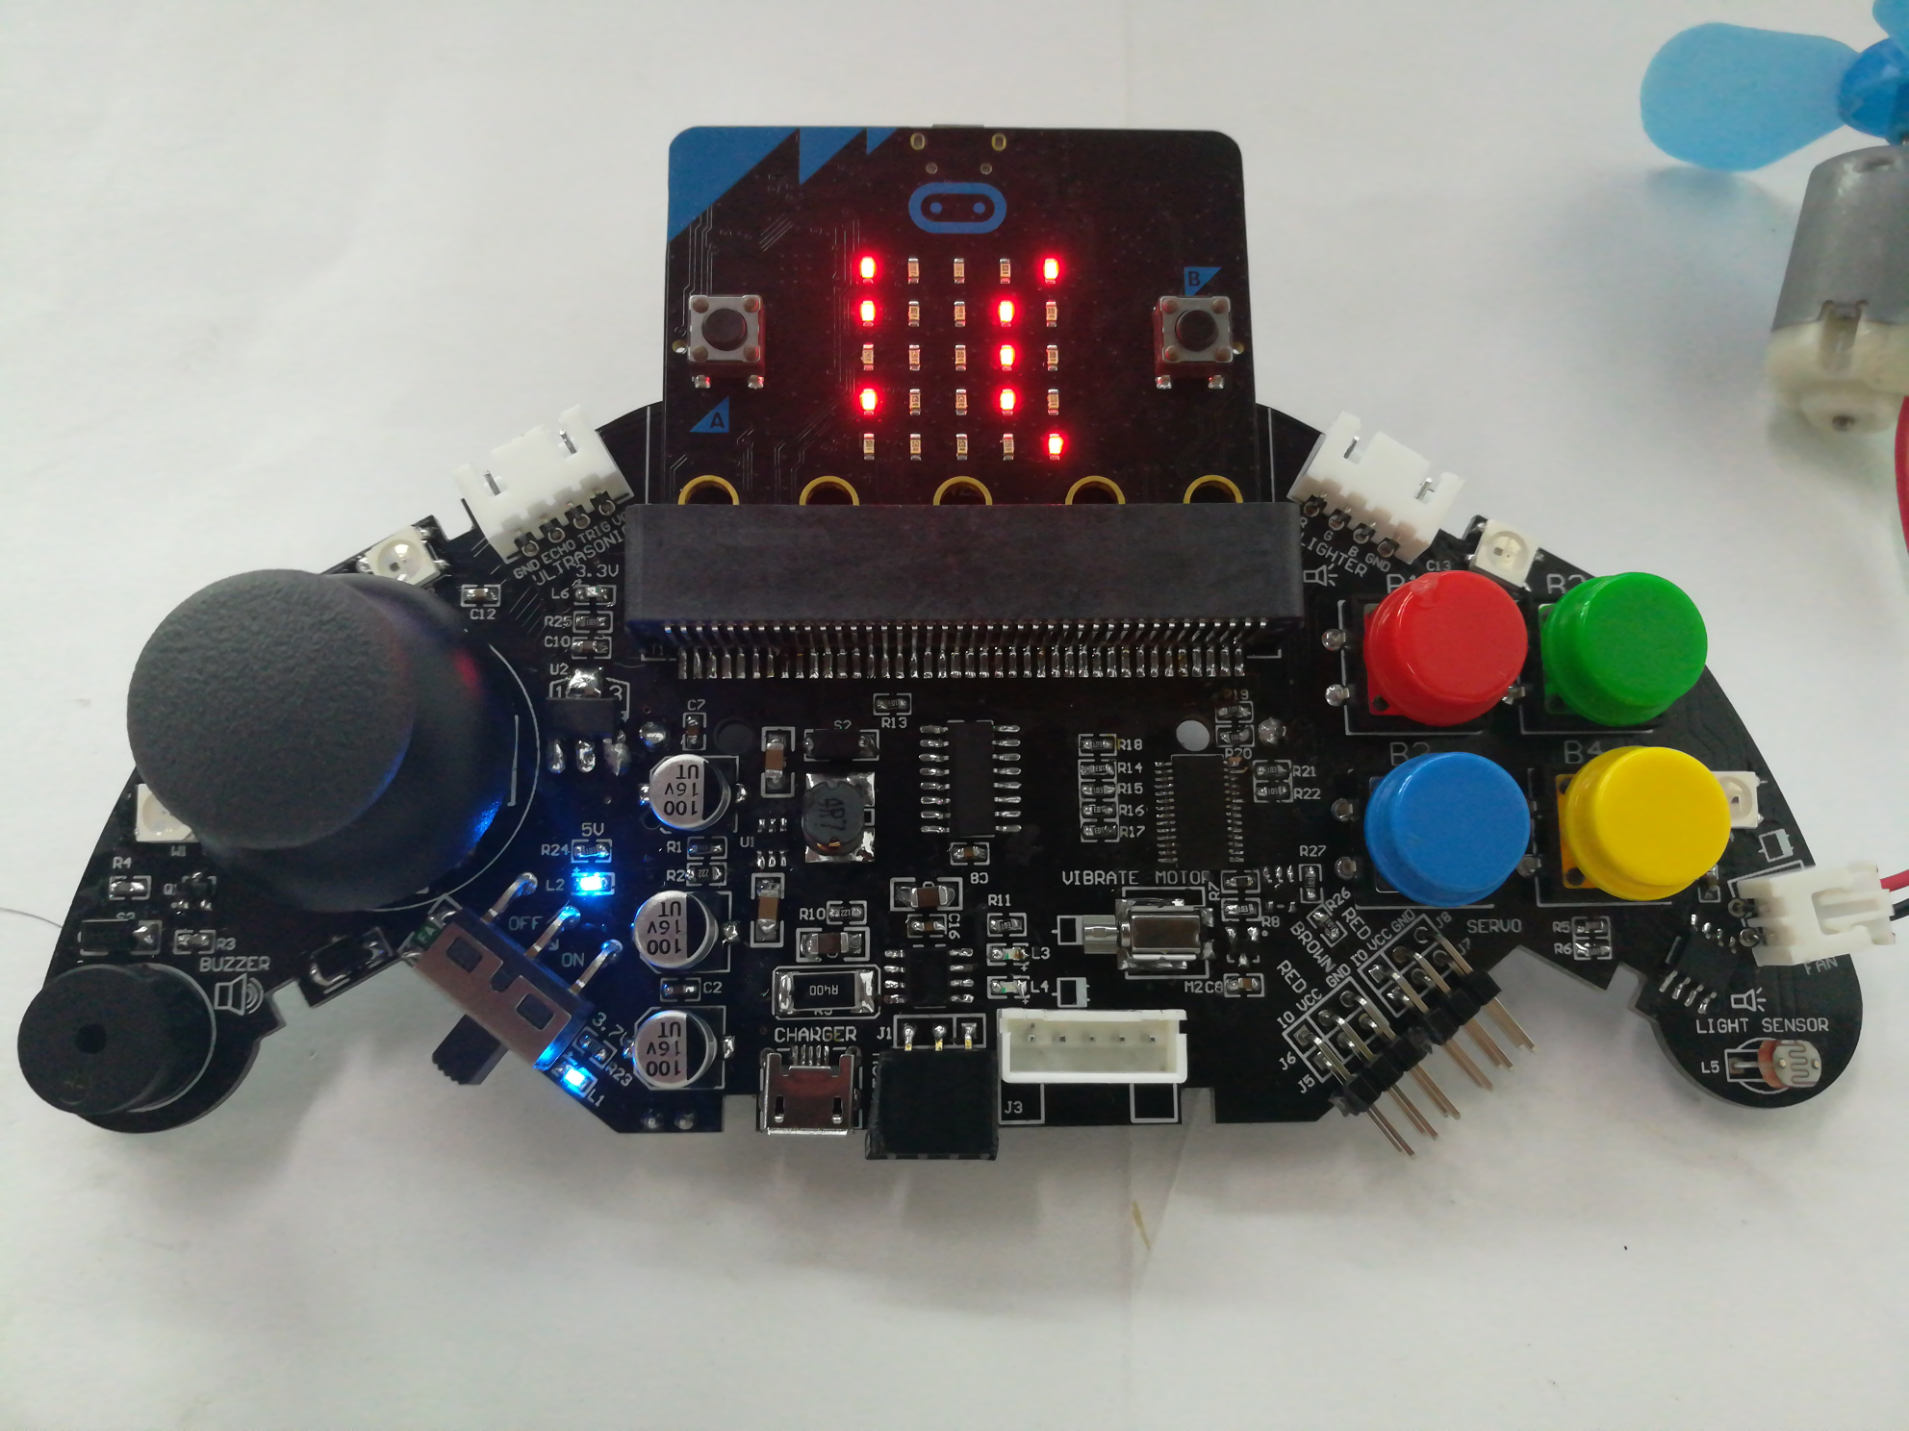
micro:bit programming tutorial
Part1
The threshold is set in the program. When the temperature is greater than this value, the fan automatically turns on, and when the temperature is lower than this value, it automatically turns off. The current temperature is scrolled on the LED screen. Note that since the thermometer is integrated inside the chip, the measured temperature is the chip temperature, which is higher than the actual temperature.
Yahboom micro:bit tutorial

Slide 4
micro:bit programming tutorial
Part2
Hardware：
● 1 X micro:bit Game Handle
● 1 X Micro USB Cable
Yahboom micro:bit tutorial

Slide 5
micro:bit programming tutorial
Two programming methods
Part2
1.Online: Connect Micro:bit to the computer via USB cable, and the computer will pop up a U disk and click the URL in the U disk to enter the programming interface.Enter this URL https://github.com/yahboomtechnology/ghbitlib to get the package named GHBit.
2.offline：Open micro:bit offline programming software and add GHBit package.Click on "Advanced" and select "Add Package".Enter this URL https://github.com/yahboomtechnology/ghbitlib to get the package named GHBit.
Note: If you already have a GHBit package, you don't need to add it repeatedly.
Yahboom micro:bit tutorial

Slide 6
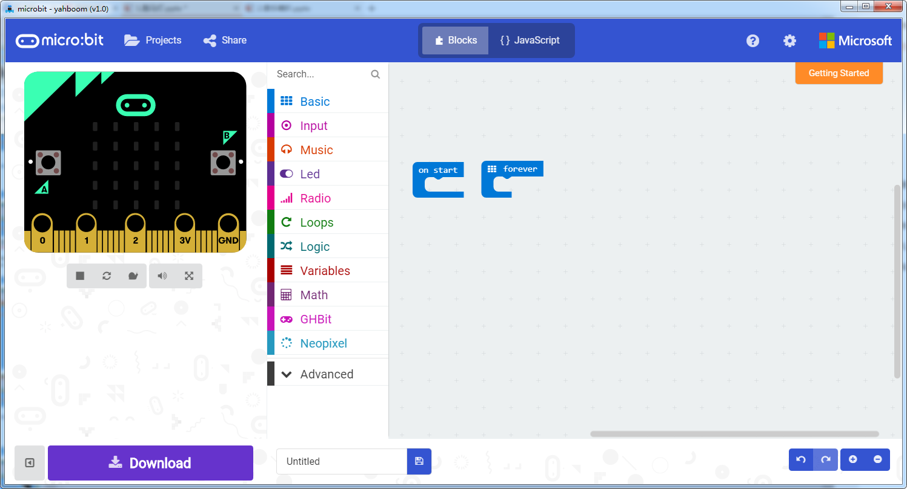
micro:bit programming tutorial
Programming interface
Part3
Yahboom micro:bit tutorial

Slide 7
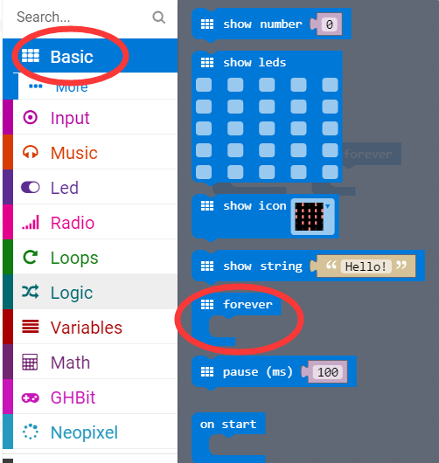
micro:bit programming tutorial
Part3
Start programming
The “forever” building block means that when the micro:bi Game Handle is turned on, the blocks in “forever” are repeatedly executed.
Yahboom micro:bit tutorial

Slide 8
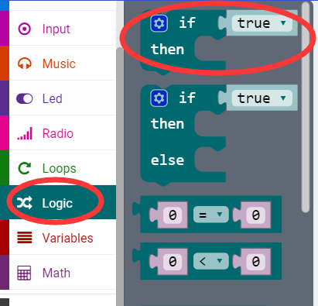
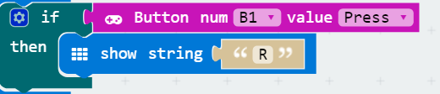
micro:bit programming tutorial
Part3
If a value is true, then do some statements.
For example: If the B1 button of the handle is pressed, the dot matrix display character R is executed. If the B1 button is not pressed, it will not be executed.
Yahboom micro:bit tutorial

Slide 9
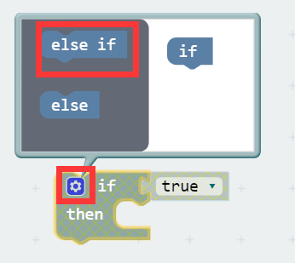
micro:bit programming tutorial
Part3
When there are many choices, you can click on the pinion above. Drag the "else if" on the left to the bottom of the "if" on the right, and click on the pinion again.
Yahboom micro:bit tutorial

Slide 10
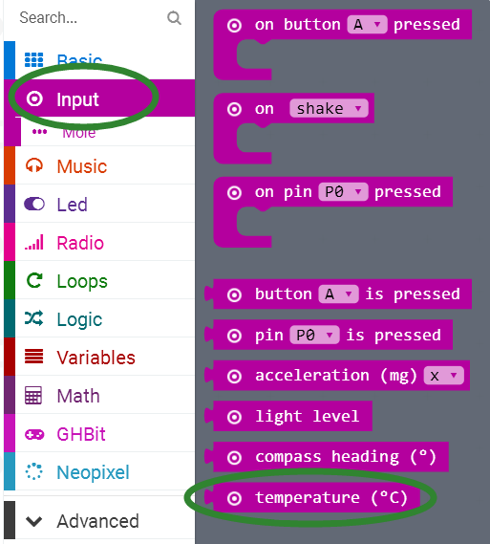
micro:bit programming tutorial
Part3
Measure the current chip temperature, so it will be higher than room temperature.
Yahboom micro:bit tutorial

Slide 11
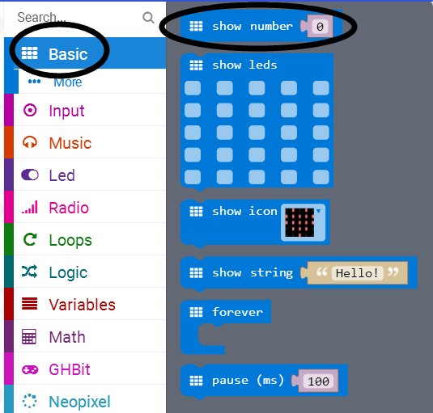
micro:bit programming tutorial
Part3
Scroll a number on the screen.If the number fits on the screen(i.e.is a single digit),do not scroll.
Yahboom micro:bit tutorial

Slide 12
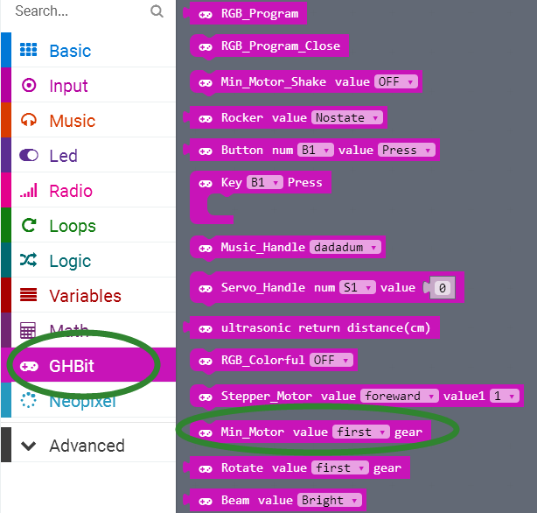
micro:bit programming tutorial
Part3
This is a fan speed control block that can change gears to adjust the wind speed.
Yahboom micro:bit tutorial

Slide 13
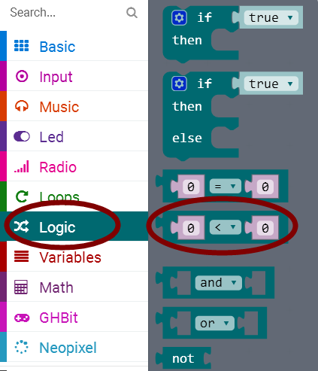
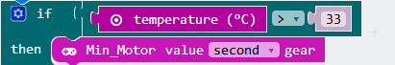
micro:bit programming tutorial
Part3
e.g:
This is a logical block, meaning that if the temperature is greater than 33 degrees, the fan will open to the second gear.
Yahboom micro:bit tutorial

Slide 14
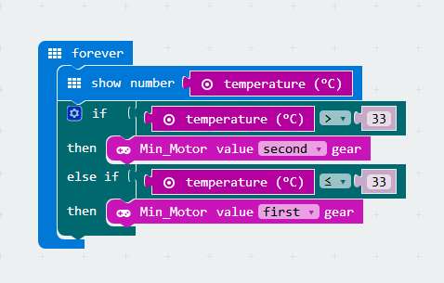
micro:bit programming tutorial
Part4
This is the complete building block for this course, let's download it to the micro:bit Game Handle.
Yahboom micro:bit tutorial

Slide 15
micro:bit programming tutorial
Part5
Do you learn the course today?
If you learn to do it, give yourself a top quack.
Now give you a homework assignment.
Make changes in the procedures of this section, add some colorful lights to make the fan not only smart but also beautiful.
Start your little brain. Try it.
Yahboom micro:bit tutorial

Slide 16
micro:bit programming tutorial
micro:bit
Thanks for watching！
Yahboom
Yahboom micro:bit tutorial

